Slide 1
An overview of Data Analyst online job postings in the United States
What Skills, Pay and Schedule a candidate may expect.
by Blue_People

Slide 2
Who are we?
Blue_People
We are a US based HR Services company conducting a market research of job postings concerning the role of Data Analyst.
Members:
Gravias Marios
Tragakis Tilemachos
Chalepas Konstantinos

Slide 3
Our_Data
Source
Timeframe
Description
Google search results for Data Analyst positions in the United States.
November 4th 2022 to present, gathered daily.
~31.500 job postings on 536 online platforms.

Slide 4
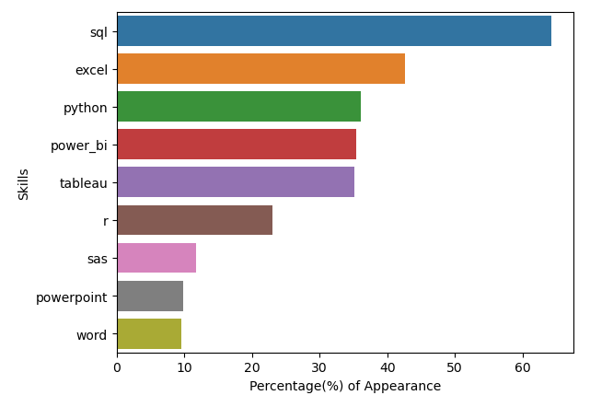
What are the most in demand skills a Data Analyst should have?
SQL is the most in demand skill followed by Excel
PowerBI and Tableau have an almost identical appearance (~33% included both)
Both Python and R are in demand but Python takes the edge. (~36% included both)

Slide 5
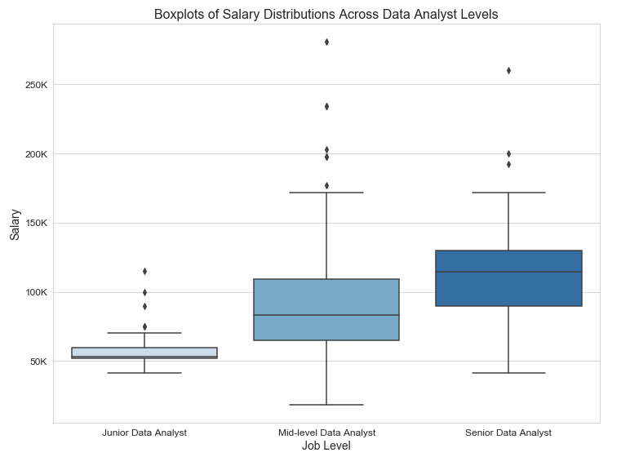
How does salary vary for different seniority levels?
Salaries rise linearly with seniority (~26K increase)
Low job offerings at Junior level
Average salary of a mid-level Data Analyst is around $86K per year

Slide 6
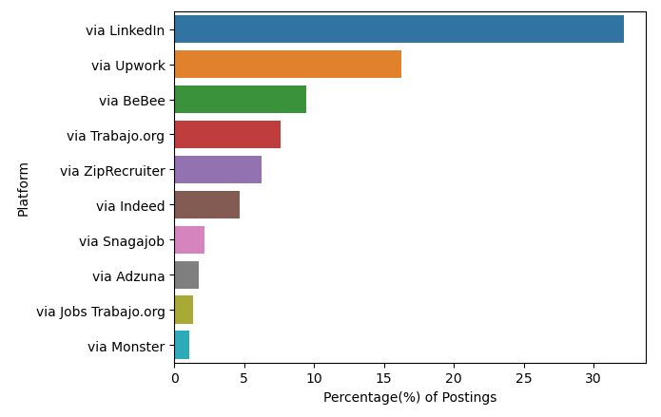
Which platforms have the most Data Analyst related postings?
Linkedin has >30% of the share
The top 5 platforms have >75% of the listings

Slide 7
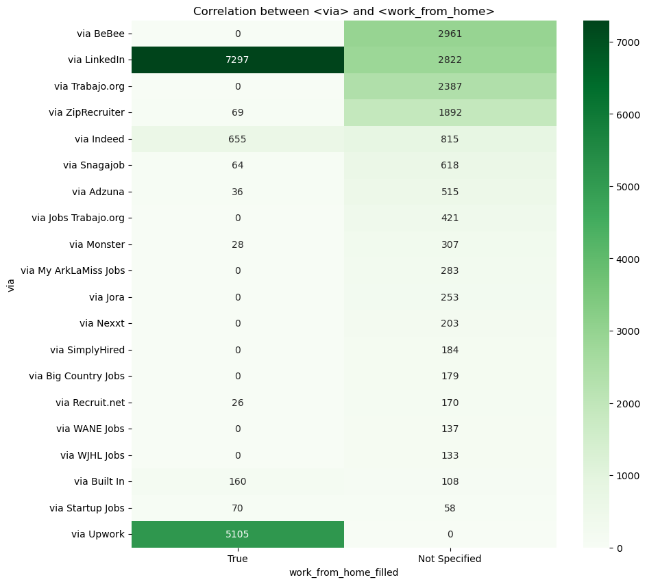
How are job postings distributed between OnSite and WFH for each platform?
Likelihood to WFH
LinkedIn: 72%
Upwork: 100%
BeBee: 0%
Trabajo.org: 0%
ZipRecruiter: 4%
Indeed: 44%

Slide 8
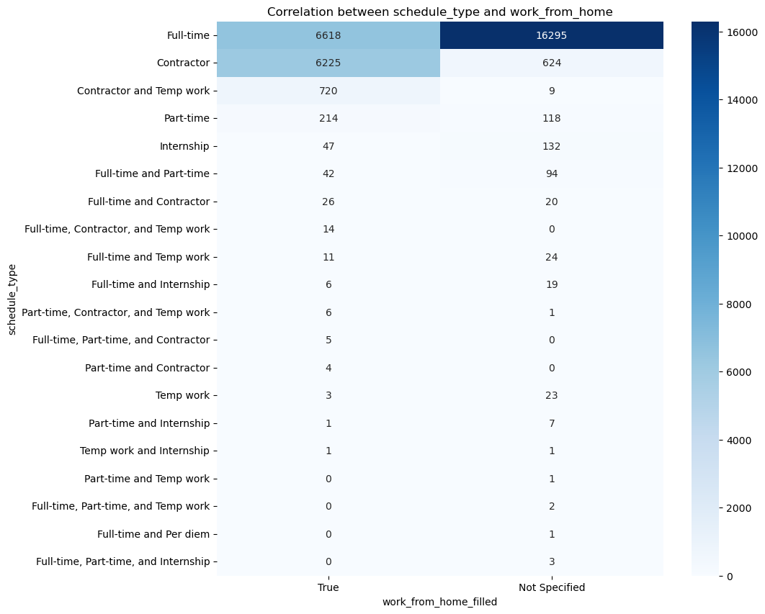
How are job postings distributed between OnSite and WFH based on work schedule?
Likelihood to WFH
Contractors: 9x
Part-time: 1.8x
Interns: 0.6x
Full-time: 0.4x

Slide 9
Conclusions
Skills
Salary
Schedule - WFH
SQL and Excel are a MUST
Python or R for coding
PowerBI or Tableau for visualizing
Average Salary ~$98K
Steady increase with longer experience
Most Remote offers are on Linkedin and Upwork
>73% of postings are full-time

Slide 10
Compare skills associated with different Data roles
Include other Data related roles
Correlate skills with salary
Further Research
Remote vs OnSite salary comparison

Slide 11
Q&A
Thank you for your time!

